Slide 1
Regression Analysis
Regression Methods
Nicoleta Serban, Ph.D.
Associate Professor
Stewart School of Industrial and Systems Engineering
Regression Analysis: Overview

Slide 2
About this lesson

Slide 3
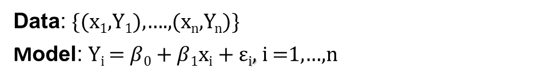
Simple Linear Regression
Data: {(x₁,Y₁),….,(x_{n},Y_{n})}
Model: Y_{i} = $β$₀ + $β$₁x_{i} + $\text{ε}$_{i}, i =1,…,n
Assumptions:
Linearity/Mean Zero Assumption : E(ε_{i}) = 0
Constant Variance Assumption: Var(ε_{i}) = σ²
Independence Assumption {ε₁,…, ε_{n}} are independent random variables
Normality Assumption: ε_{i} ~ Normal
Notes:
SHOW SLIDE ONLY

Slide 4
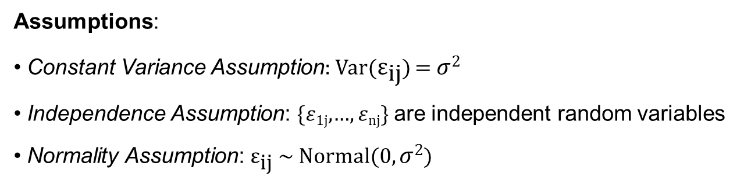
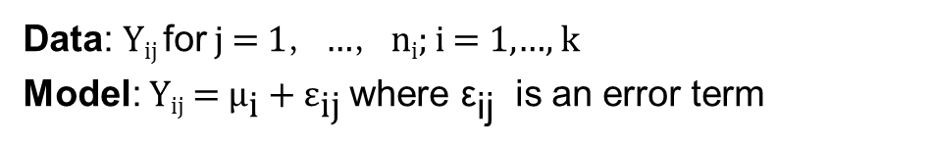
ANOVA
Data: Y_{ij} for j = 1，…，n_{i}; i = 1,…, k
Model: Y_{ij} = ${\text{μ}}_{\text{i}}+{\text{ε}}_{\text{ij}}$ where ${\text{ε}}_{\text{i}\text{j}}$ is an error term
Assumptions:
Constant Variance Assumption: Var(${\text{ε}}_{\text{ij}}$) = $σ$²
Independence Assumption: {$ε$_{1j},…, $ε$_{nj}} are independent random variables
Normality Assumption: ${\text{ε}}_{\text{ij}}$ ~ Normal(0, $σ$²)

Slide 5
Multiple Linear Regression
Data: {(x₁₁,.., x_{1p}),Y₁},….,{(x_{n1},.., x_{np} ),Y_{n}}
Model: Y_{i} = β₀ + β₁x_{i1} + β₂x_{i2} +…+ β_{p}x_{ip} + ε_{i}, i =1,…,n
Assumptions:
Linearity/Mean Zero Assumption: E(ε_{i}) = 0
Constant Variance Assumption: Var(ε_{i}) = σ²
Independence Assumption: {ε₁,…, ε_{n}} are independent random variables
Normality Assumption: ε_{i} ~ Normal

Slide 6
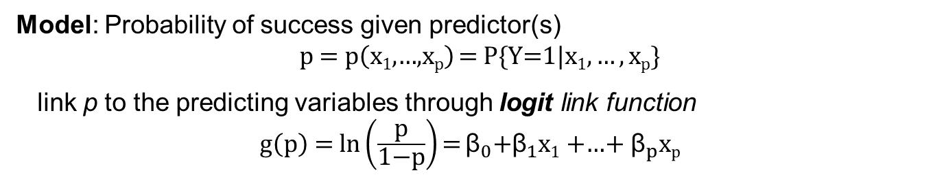
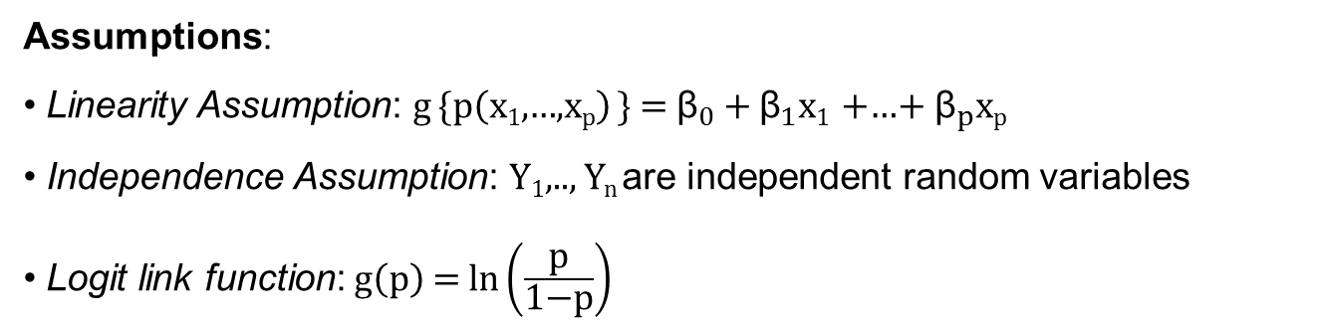
Logistic Regression
Data: {(x₁₁,.., x_{1p}),Y₁},….,{(x_{n1},.., x_{np} ),Y_{n}} where Y₁,.., Y_{n} binary responses
Model: Probability of success given predictor(s)
$$\text{p} \text{=} \text{p}\left(\text{x}\text{1}\text{,…,}\text{x}\text{p}\right) \text{=} \text{P}\{\text{Y}\text{=1}|\text{x}\text{1},…,\text{x}\text{p}\}$$
link p to the predicting variables through logit link function
${\text{g}\left(\text{p}\right) \text{=} \text{ln}\left(\frac{\text{p}}{\text{1−}\text{p}}\right){\text{=}}\text{β}}_{0}\text{+}{\text{β}}_{1}\text{x}\text{1}$ +…+${ \text{β}}_{p}\text{x}\text{p}$
Assumptions:
Linearity Assumption: $\text{g}{\text{\{}\text{p}\left(\text{x}\text{1}\text{,…,}\text{x}\text{p}\right)}\text{\} = }{\text{β}}_{0}+{\text{β}}_{1}\text{x}\text{1}$ +…+${ \text{β}}_{p}\text{x}\text{p}$
Independence Assumption: Y₁,.., Y_{n} are independent random variables
Logit link function: $\text{g}\left(\text{p}\right)\text{ = }\text{ln}\left(\frac{\text{p}}{\text{1−}\text{p}}\right)$

Slide 7
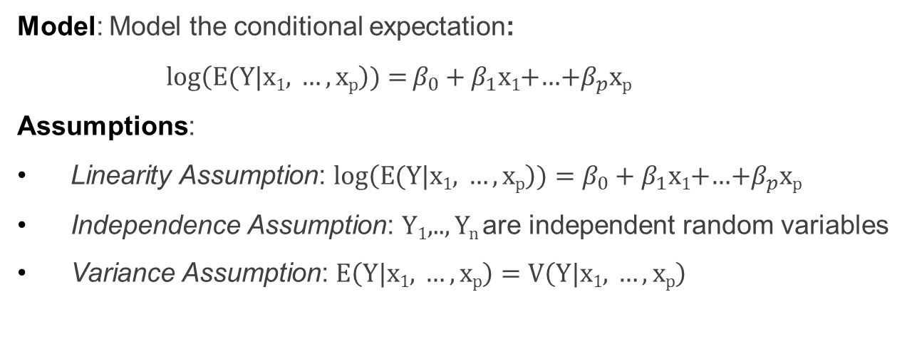
Poisson Regression
Data: {(x₁₁,.., x_{1p}),Y₁},….,{(x_{n1},.., x_{np} ),Y_{n}} where Y₁,.., Y_{n} count response variable
Model: Model the conditional expectation:
${log\left(E(Y|\text{x}\text{1}\text{,} …,\text{x}\text{p}\right)){=}β}_{0}+β_{1}\text{x}\text{1}$+…+$β_{p}\text{x}\text{p}$
Assumptions:
Linearity Assumption: $log\left(E(Y|\text{x}\text{1}\text{, }…,\text{x}\text{p}\right))=β_{0}+β_{1}\text{x}\text{1}$+…+$β_{p}\text{x}\text{p}$
Independence Assumption: Y₁,.., Y_{n} are independent random variables
Variance Assumption: $E\left(Y|\text{x}\text{1}\text{, }…,\text{x}\text{p}\right)=V\left(Y|\text{x}\text{1}\text{, }…,\text{x}\text{p}\right)$

Slide 8
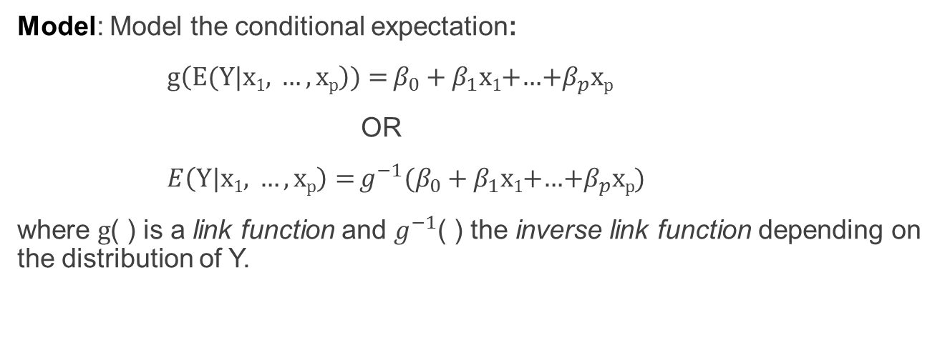
Generalized Linear Model
Data: {(x₁₁,.., x_{1p}),Y₁},….,{(x_{n1},.., x_{np} ),Y_{n}} where Y₁,.., Y_{n} response variable with a distribution from the exponential family
Model: Model the conditional expectation:
${g\left(E(Y|\text{x}\text{1}\text{,} …,\text{x}\text{p}\right)){=}β}_{0}+β_{1}\text{x}\text{1}$+…+$β_{p}\text{x}\text{p}$
OR
${E\left(Y|\text{x}\text{1}\text{, }…,\text{x}\text{p}\right){=}g^{−1}(β}_{0}+β_{1}\text{x}\text{1}$+…+$β_{p}\text{x}\text{p}$)
where $g$( ) is a link function and $g^{−1}$( ) the inverse link function depending on the distribution of Y.

Slide 9
Weighted Least Regression (WLS)
Data: {(x₁₁,.., x_{1p}),Y₁},….,{(x_{n1},.., x_{np} ),Y_{n}}
Model: Y_{i} = β₀ + β₁x_{i1} + β₂x_{i2} +…+ β_{p}x_{ip} + ε_{i}, i =1,…,n
Assumptions: For the vector of errors ε = (ε₁, ..., ε_{n})
Linearity/Mean Zero Assumption: E(ε) = 0
Covariance-Variance Assumption: V(ε) = Σ
Independence Assumption: {ε₁,…, ε_{n}} are independent random variables
Normality Assumption: ε ~ Normal

Slide 10
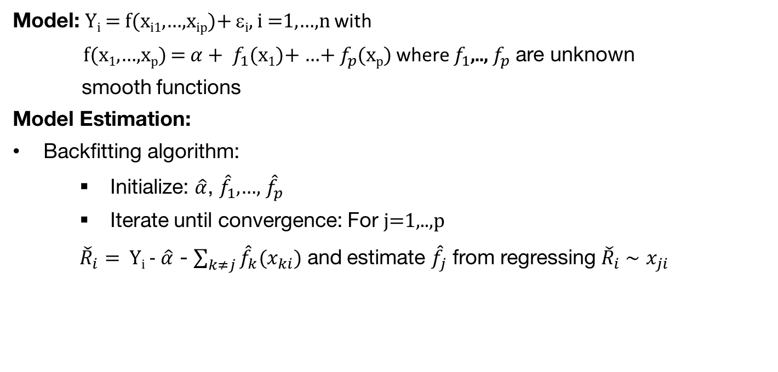
Generalized Additive Model (GAM)
Model: Y_{i} = f(x_{i1},…,x_{ip})+ ε_{i}, i =1,…,n with
f(x₁,…,x_{p}) = ${α+ f}_{1}$(x₁)+ …+ $f_{p}$(x_{p}) where $f_{1}$,.., $f_{p}$ are unknown
smooth functions
Model Estimation:
Backfitting algorithm:
  Initialize: $\hat{α}$, ${\hat{f}}_{1}$,…, ${\hat{f}}_{p}$
  Iterate until convergence: For j=1,..,p
  ${\check{R}}_{i}=$ Y_{i} - $\hat{α}$ - $\sum_{k≠j}{{\hat{f}}_{k}(x_{ki})}$ and estimate ${\hat{f}}_{j}$ from regressing ${\check{R}}_{i} \sim$ $x_{ji}$

Slide 11
Summary

